Slide 1


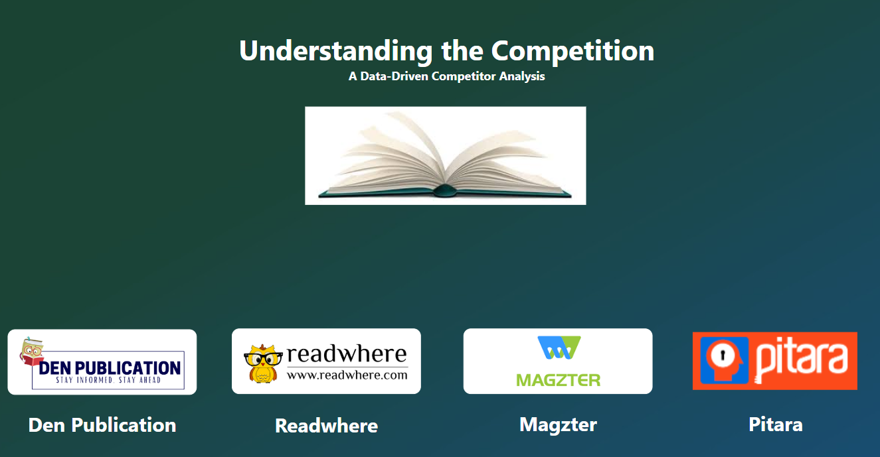
Understanding the Competition
A Comparative Study of Market Competitors & Growth Opportunities
Presented by: Priyanka Sahu
Designation: Business Analyst Intern
Company: Den Publication

Slide 2
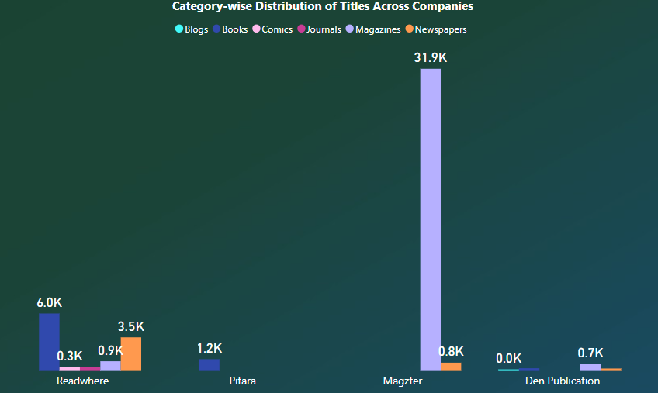
Competitive Landscape: Den Publication vs. Competitors
Overview of Competitors
Readwhere: Offers Books ,Newspapers , Magazines , Journals ,and Comics. A diverse platform with a vast book collection.
Magzter: Specializes in Magazines and Newspapers. Leading in digital subcriptions .
Pitara: Focuses on Children’s Books and Comics. A niche platform catering specifically to young readers.
Den Publication: Provides Books, Newspapers, Magazines, and Blogs. With strong magazines presence but a smaller content library.
1

Slide 3

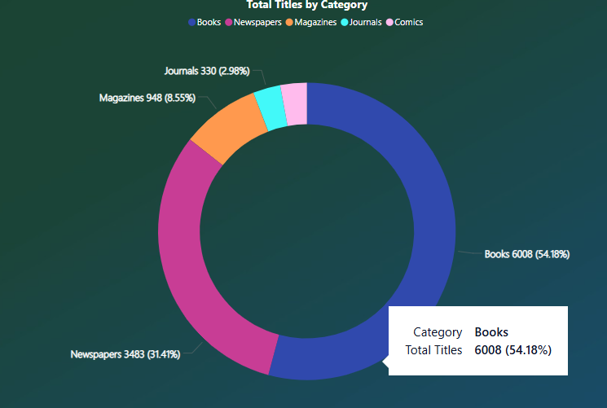
Readwhere : Digital & Print Giant
✅ Established: 2009 ✅ Content Portfolio:
Books (6008) include Education, Self-Help, Fiction, and Literature, etc., with Fiction having the highest records.
Magazines (943) cover Business, Education, Lifestyle, and Entertainment, etc., where Lifestyle dominates.
Newspapers (3483) are available in Hindi, English, Marathi, and Punjabi, etc., with Hindi leading.
Journals (330) consist of Business, Education, Finance, and Medical, etc., with Business having the highest records.
Comics (320) feature Fantasy, Kids, Entertainment, and Education, etc., where Entertainment dominates.
Total Subcategories: 57
📌 Overall Insights: Hindi-language newspapers have the highest data.
✅ Strengths: ✔️ Large content portfolio across all categories. ✔️ Strong presence in Hindi newspapers. ✔️ A diverse range of books and journals.
2

Slide 4
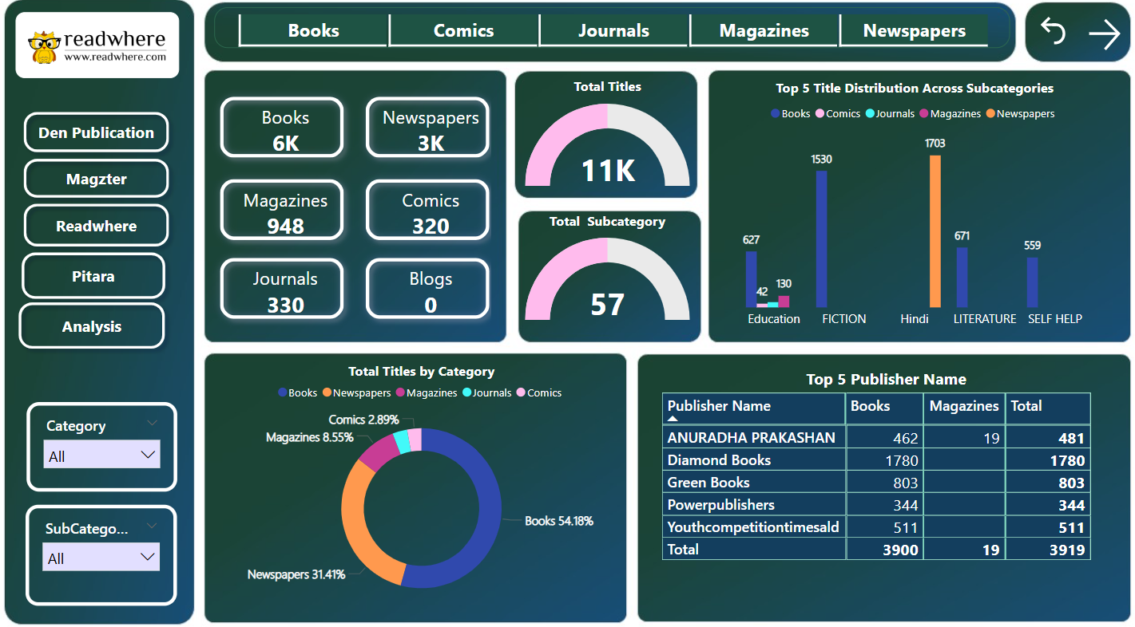

Slide 5

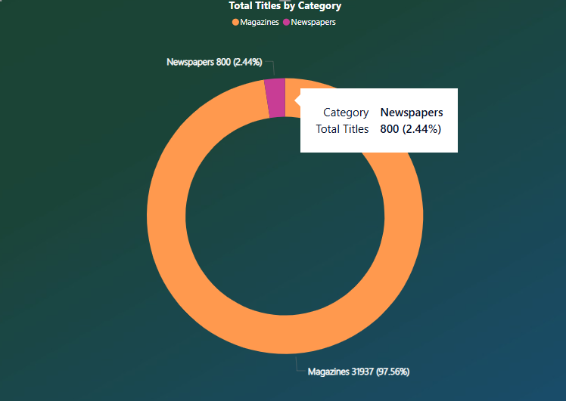
Magzter: The Magazine Powerhouse
✅ Established: 2011 ✅ Content Portfolio:
Newspapers (800) are available in Hindi, English, Telugu, Tamil, and Afrikaans, etc., with English having the highest records.
Magazines (31,937) cover Academic, Business, Lifestyle, and Education, etc., with Academic securing the highest records.
Total Subcategories: 74
📌 Overall Insights: English newspapers and Academic magazines lead in content volume.
✅ Strengths: ✔️ Largest magazine collection among competitors. ✔️ Strong digital and international presence. ✔️ Wide variety of content categories.
3

Slide 6
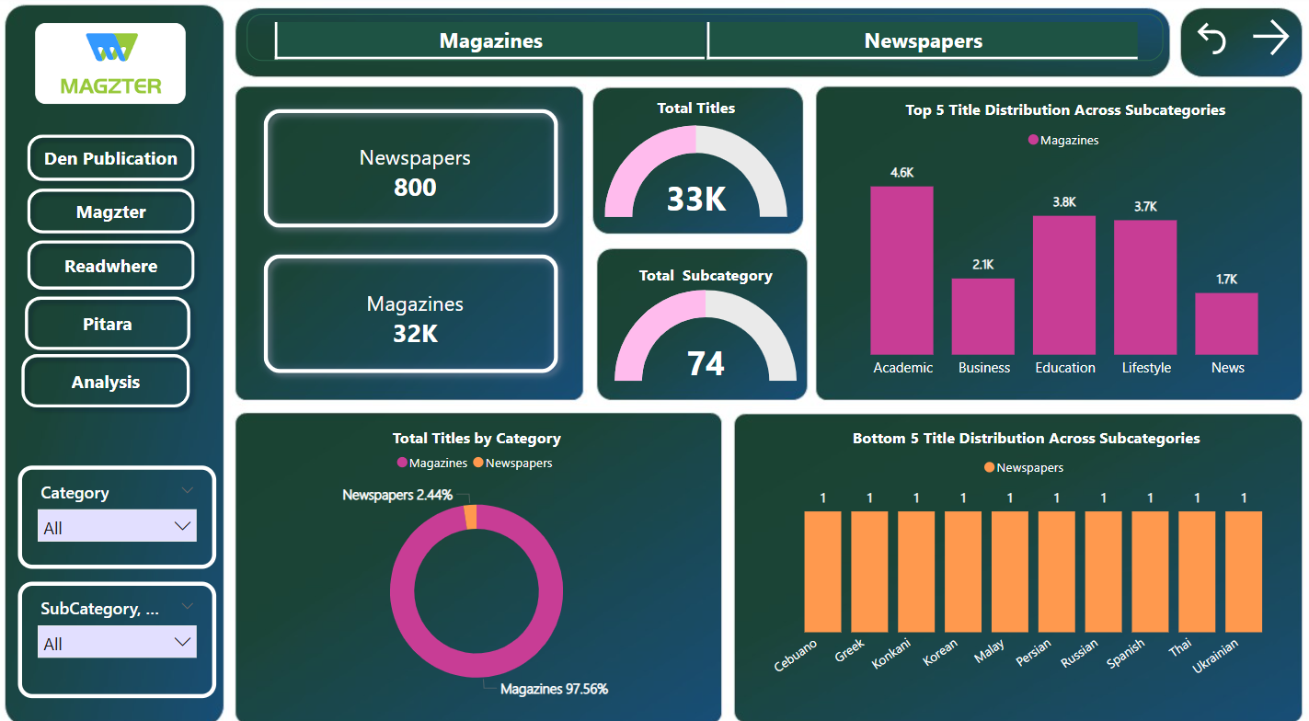

Slide 7

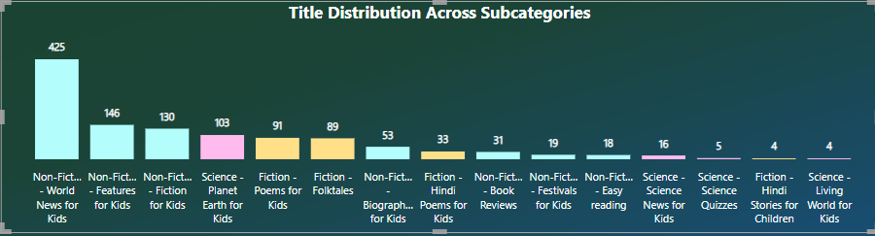
Pitara: A Leading Platform for Children's Literature
✅ Established: 1998
✅ Content Portfolio:
Books (1,167) are available in 15 subcategories, including:
Non-Fiction: The World News for Kids, Poems for Kids, Hindi Poems, etc.
Fiction: Stories and creative literature for children.
Science: Educational and engaging content for young learners.
📌 Overall Insights: Pitara specializes in children's books and educational content, with a mix of fiction, non-fiction, and science-based reading materials.
✅ Strengths: ✔️ Dedicated to children's education and entertainment. ✔️ Rich collection of poetry, stories, and world news tailored for kids. ✔️ Strong focus on Hindi and English content, making it accessible to a diverse audience.
4

Slide 8
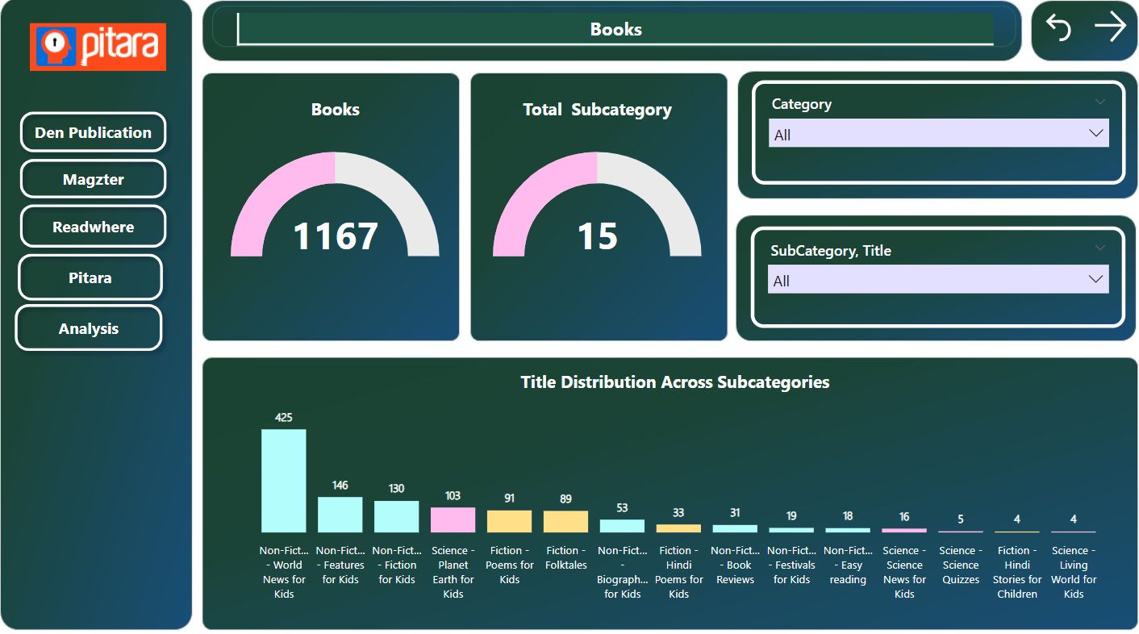

Slide 9
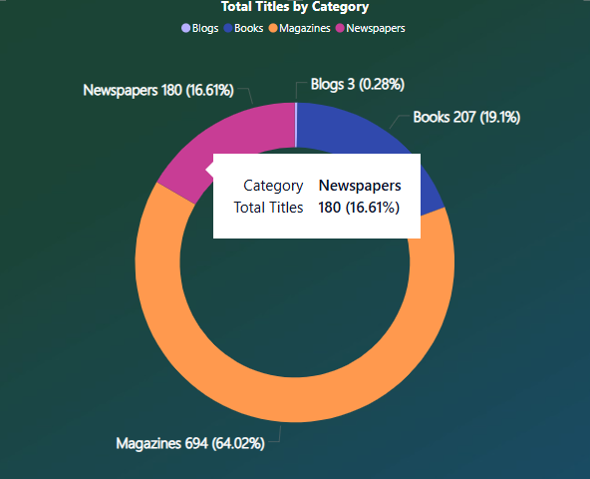
Den Publication: Strengths & Opportunities
✅ Established: 2017
✅ Content Portfolio:
Books (207) contain Biography, Comics, Education, Inspiration, and Kids categories, etc. in which Education has the highest records.
Magazines (694) include Business, Cooking, Health, and Lifestyle, etc. where Business dominates.
Newspapers (180) are available in Bengali, Hindi, English, and Marathi, etc. with English having the highest count.
Total Subcategories: 43
📌 Overall Insights: English-language and Business content dominate across categories.
✅ Strengths:
Strong presence in books, newspapers, and magazines.
Well-established print media reputation.
Growing digital potential.
✅ Areas for Growth:
Expand book collection to match competitors.
Strengthen digital presence & subscriptions.
Add journals or niche content for diversity.
5

Slide 10
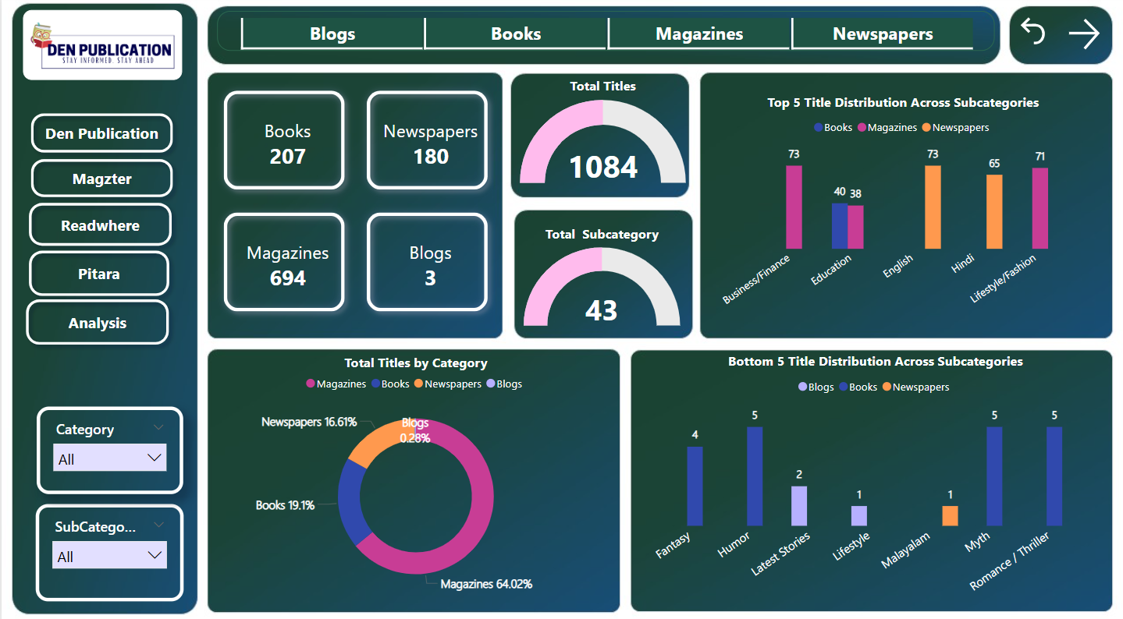

Slide 11
Competitive Landscape - Den Publication vs. Competitors
Content Volume Comparison
Company | Books | Newspapers | Magazines | Journals | Comics | Blogs
Den Publication | 207 | 180 | 694 | ❌ | ❌ | 3
Readwhere | 6008 | 3483 | 943 | 330 | 320 | ❌
Magzter | ❌ | 800 | 31,937 | ❌ | ❌ | ❌
Pitara | 1167 | ❌ | ❌ | ❌ | ❌ | ❌
Insights from Competitor Offerings
Readwhere dominates in books but has fewer magazines than Magzter.
Magzter is the market leader in magazines, but lacks books & journals.
Den Publication has a strong magazine presence but fewer books & newspapers compared to competitors.
Pitara Kids specializes in children's content with a strong book portfolio, including fiction, non-fiction, science, and poetry.
6

Slide 12
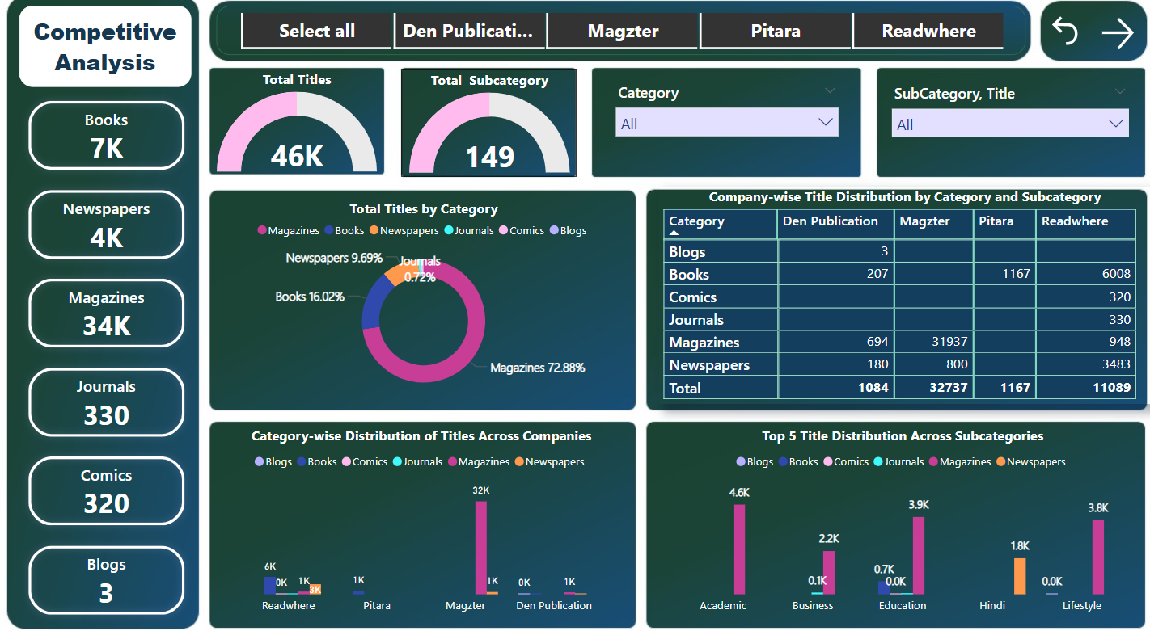

Slide 13
Strength and Weakness
Company | Strengths | Weaknesses
Den Publication | Strong in magazines, presence in books & newspapers | Smallest content library, lacks journals & comics
Magzter | Leading in magazine content, strong digital presence. | No books or journals, fewer newspapers.
Readwhere | Largest book collection, diverse content types. | Less focus on newspapers & magazines compared to Magzter.
Pitara | Specializes in children's books & comics. | No magazines, newspapers, or journals.
7

Slide 14
Conclusion & Future Roadmap
Summary of Findings:
Readwhere: Strong in books & diverse content categories.
Magzter: Dominates magazines & digital subscriptions.
Den Publication: Balanced but needs expansion & digital transformation.
Future Strategy:
Expand book collection to attract a wider audience.
Develop digital subscription models for sustained revenue.
Diversify content (consider adding journals & niche publications).
Website Improvement
8

Slide 15
Other Competitors
Indian Competitors:
Pratilipi - A storytelling platform for books, magazines, and comics.
Amar Chitra Katha - A major player in Indian comic books.
National digital Library of India - Providing free access to books, research papers, and study materials.
Rashtriya e-Pustakalaya - Provides free digital access to books, study materials.
International Competitors:
PressReader – Offers newspapers and magazines digitally.
Scribd – Subscription-based digital library.
Zinio – Digital magazine platform.
8

Slide 16
THANK YOU!
9

